Slide 1

TEAM ASSIGNMENT 1
Software Measurement and Analysis
Team : K15T1_Team11
Project Name: Viking Project

Slide 2

TEAM MEMBERS
Le Dinh Thach Huyen (Sub-leader)
Dang Huy Son (Member)
Do Minh Tam (Recorder)
Nguyen Trung Tin (Member)
Le Thi Bich Van (Leader)

Slide 3

CONTENTS
1. The process of team
2. Roles & Responsibility
3. Schedule

Slide 4
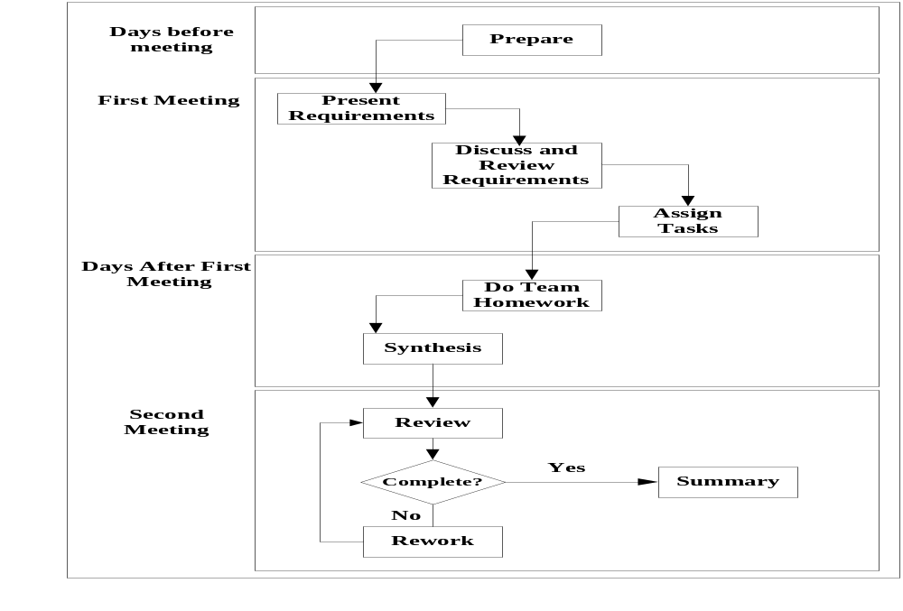
THE PROCESS OF TEAM

Slide 5
ROLES
1. The facilitator
2. Leader
3. Sub – leader
4. Record
5. Members

Slide 6
RESPOSIBILITIES

Slide 7
THE FACILITATOR
To Dinh Hieu
  The facilitator is not a member of the team.
  Owner of the overall business change that is being supported by team assignments.
  Acts as resources to the team by intervening when necessary to keep the team on track.

Slide 8
LEADER
Le Thi Bich Van:
  Planning the project.
  Design project control mechanisms
  Manage project scope.
  Manage and report progress
  Be accountable for quality
  Assigns the activities for each of the team members
  Preparing the meeting agenda

Slide 9
LEADER
Le Thi Bich Van
  Facilitate the team process, ensures that all members participate during the meetings, prevents other members from dominating, actively participates
  Ensures that team decisions are made by consensus where appropriate
  Monitor the status, assuring timely completion of assignments: Oversees day-by-day operations.
  Review: effort log and team assignment
  Evaluate the work of its members. Reward and punish.

Slide 10
SUB - LEADER
Le Dinh Thach Huyen
  Participate as a team member
  Support Leader: analysis of the main requirements and prepare an agenda for the meeting.
  Present the documents for the team to review during the meeting and distribute them after the meeting in a timely manner.
  Provide and develoment resources, include :Internal documentation and system documentation.
  Sup - Leader will have received completed parts of the assignment from other members of the team and then comment on the whole assignment.

Slide 11
RECORDER
Do Minh Tam
  Participate as a team member
  Integrate effort log every week
  Record meeting minutes every meeting

Slide 12
MEMBERS
  Estimate the work that will be assigned to them.
  Plan their own work
  Record effort log every day and report status of their work.
  Sign up to their task plan : Do teamwork, team member must complete their assigned works on time.
  Be accountable for the quality of their work.
  Alert their team leader of problems and issues, ...

Slide 13
MEMBERS
  Read documents before the first meeting every assignment.
  Listens carefully and asks questions.
  Is enthusiastic-it’s contagious and helps galvanize the entire team.
  Understands and is committed to team objectives.
  Suggest improvements to the project plan, control processes...
  Gives honest, sincere appreciation.

Slide 14
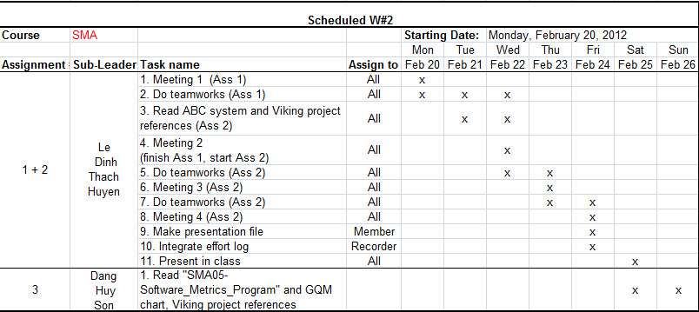
SCHEDULES

Slide 15
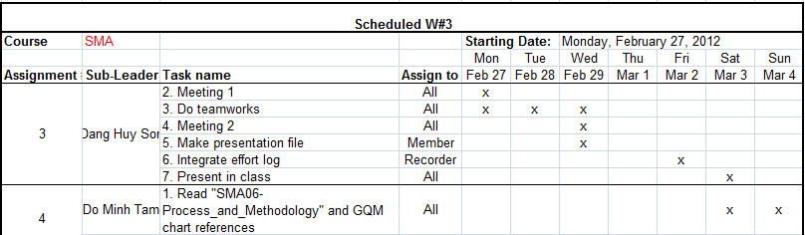
SCHEDULES

Slide 16



